Slide 1





METROCAR PROJECT
Overview of Performance Metrics
Dr. Otieno J. A.; Kyprianou L.
Masterschool Data Analytics 18th of October 2024 Masterschool - Berlin

Slide 2
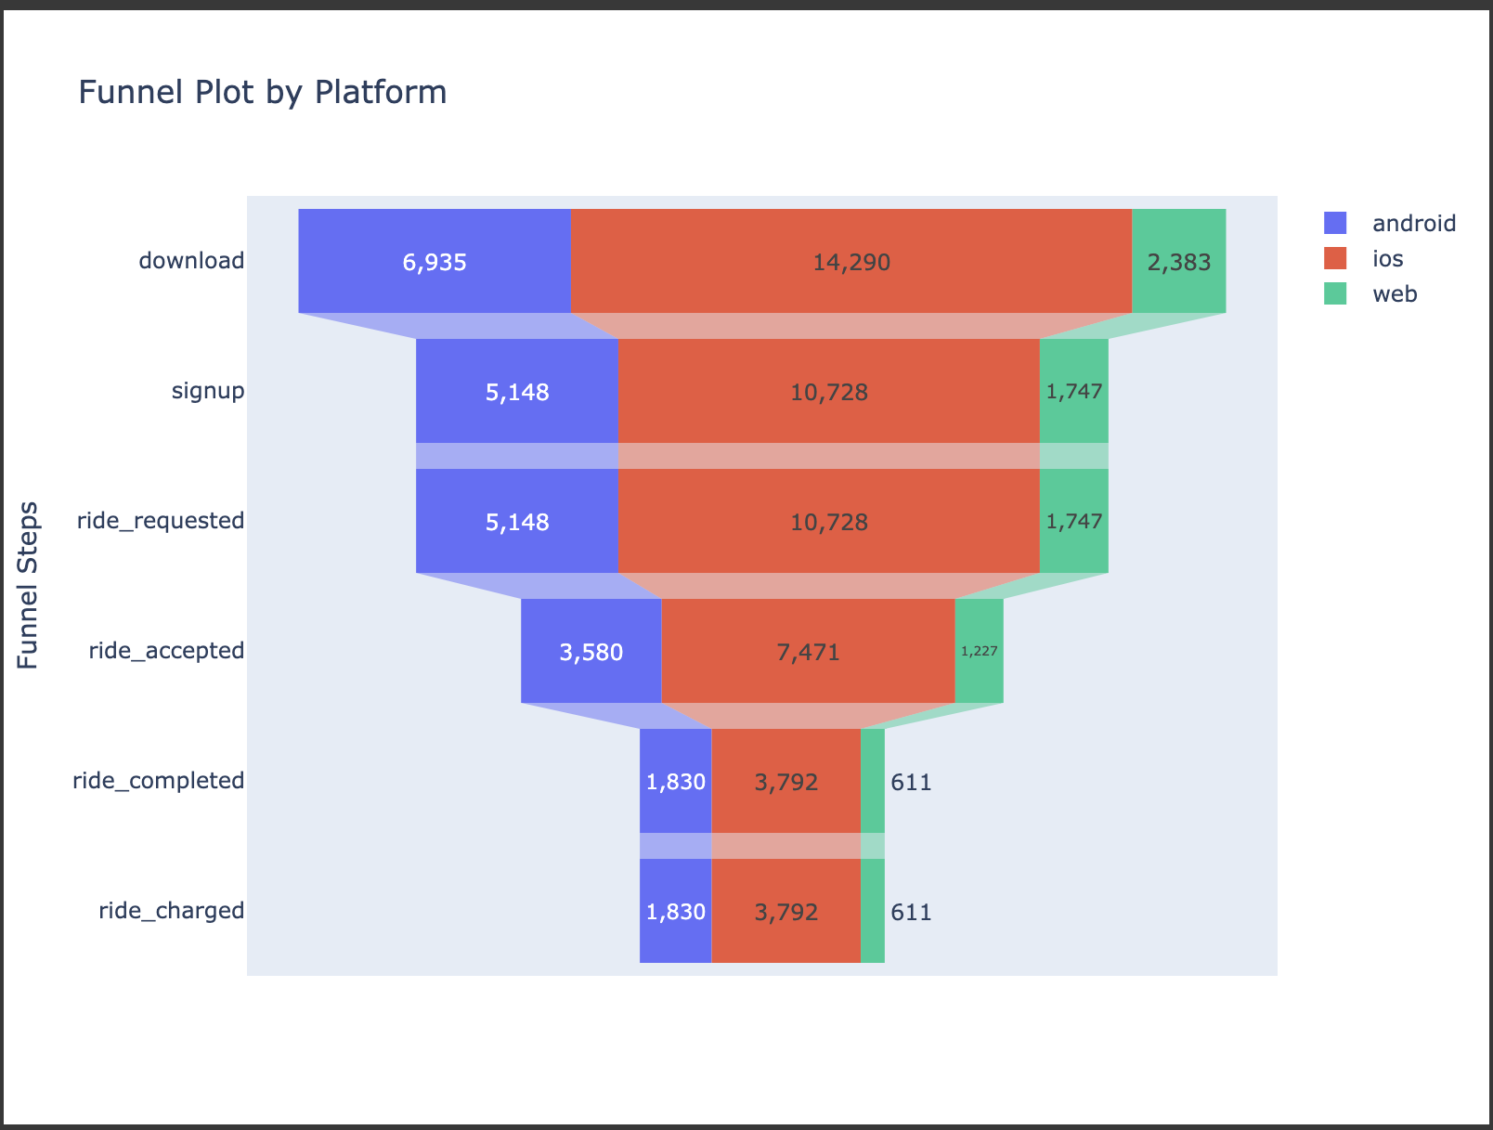
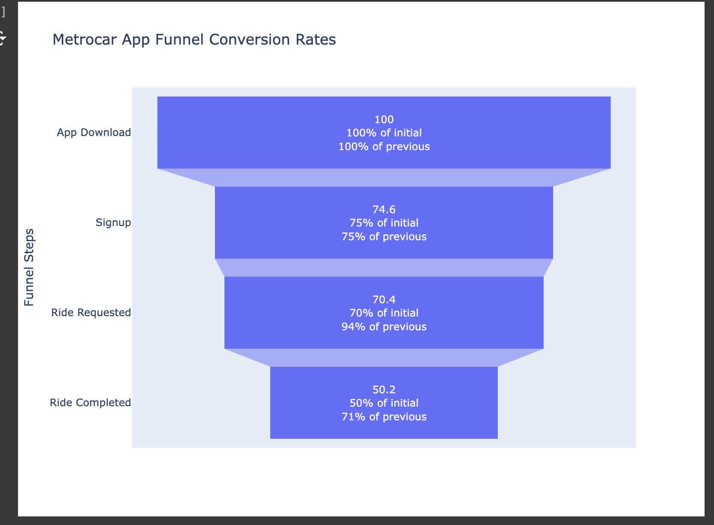
Funnel Analysis of User Drop-Off Points
Signup Drop-off (25.4%): Simplify signup and offer discounts or third-party login
Ride Request Drop-off (29.6%): Simplify payments setup and offer onboarding or first-ride free promotions
Ride Completion Drop-off (49.8%): Reduce cancellations by improving driver availability, pricing clarity and user trust
Payment Barrier: Ease payment setup to boost ride requests
Ride Experience: Enhance app performance and build trust with driver ratings and cost transparency
Key Focus: Make ride requests easier and cut cancellations for better conversions

Slide 3
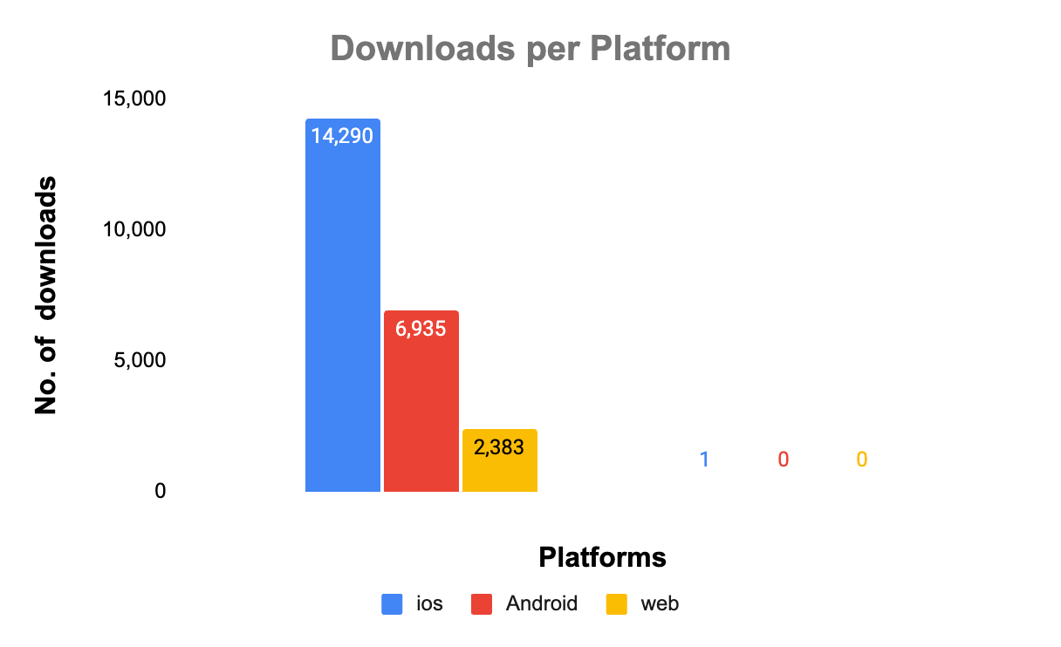
Platform-Based Marketing Budget Recommendations
iOS Dominance: users at 60.50%, likely due to higher purchasing power and better app experience
Android Opportunity: makes 29.40%, room for improvement through optimization & feedback
Web Platform: users at 10.10%; enhancing its experience could attract more desktop users.
Generally, there are 27.81% ios users as compared to 71.47% Android users (StatCounter, GSMA Intelligence)
Platform-Specific Marketing: Invest in iOS campaigns and strengthen Android outreach for broader market
Competitor Comparison: Analyze platform distribution to see if trends align with the broader market
Platform | ios | Android | web | Total downloads
Counts | 14,290 | 6,935 | 2,383 | 23,608
Percentage | 60.50% | 29.40% | 10.10%

Slide 4
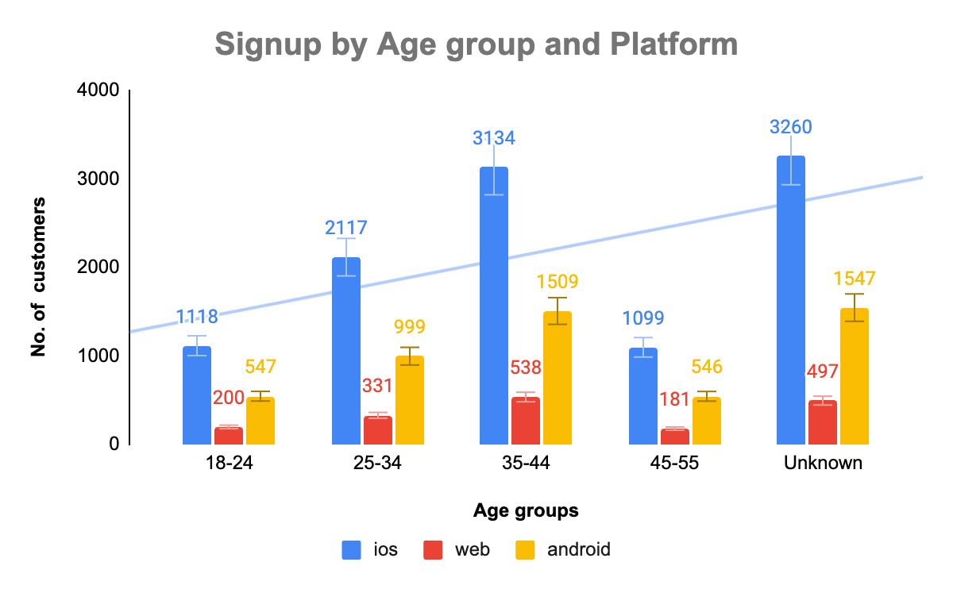
Age Group Performance and Target Customer Insights
Top Performing Age Groups: The 35-44 group leads at 29.4%, followed by 25-34 at 19.56%.
Unknown Age Data: 30.10% of users have no recorded age data, requiring further investigation.
Target Customers: Focus on 35-44 and 25-34 age groups, likely due to stable income and mobility needs.
Young Users: The 18-24 group, though smaller, is a tech-savvy audience with future growth potential.
Data Improvement: Encourage profile completion and surveys to reduce unknown data and refine targeting strategies.
Age groups | 18-24 | 25-34 | 35-44 | 45-55 | Unknown
Percentage | 10.58% | 19.56% | 29.40% | 10.36% | 30.10%

Slide 5
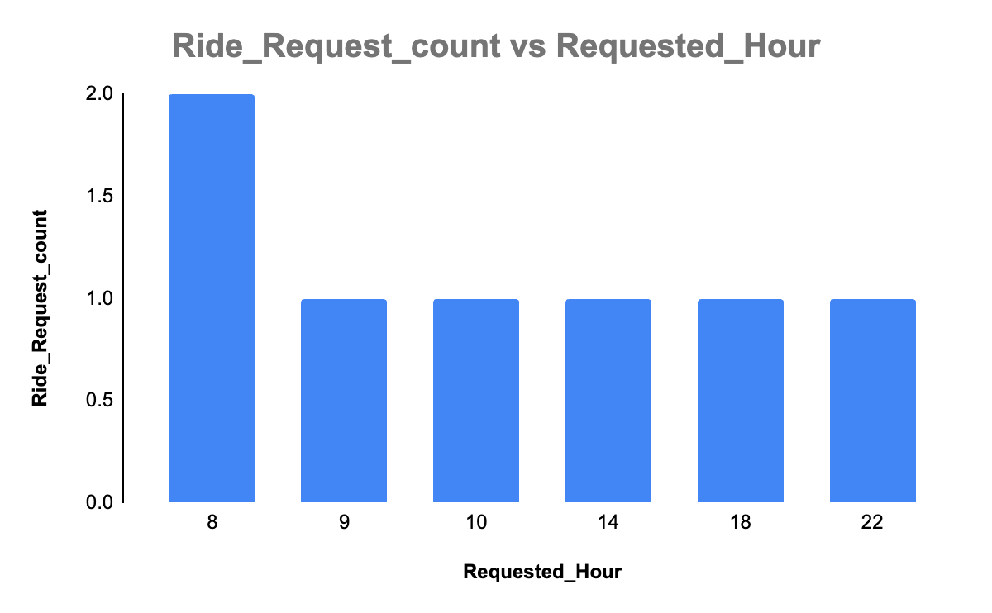
Peak Demand Insights;
Ride Request Distribution for Surge Pricing Strategy
Peak ride demand for commuters is at 8 AM, ideal for surge pricing.
Significant drop in demand occurs during other hours.
Recommendations
Analyze ride data to identify peak hours and demand patterns
Test surge pricing at peak hours and evaluate its effects on revenue & customer satisfaction.
Continuously track demand trends and adjust pricing strategies in real-time.

Slide 6
Lowest Conversion Rate and Improvement Strategies
Lowest Conversion Point: “Ride Accepted → Ride Completed” has the lowest conversion rates across all platforms (Android: 51.1%, iOS: 50.7%, Web: 49.8%).
Reduce Cancellations: Address rider and driver cancellation reasons
Driver Availability: Ensure more drivers are available and offer incentives
Real-Time Support: Provide real-time notifications and support to reduce drop-offs
Customer Feedback: Collect feedback from users who cancel rides, solve problems
Improve Experience: Focus on enhancing the ride experience

Slide 7
Recommendations for Service Optimization
Simplify signup, improve payments, and reduce cancellations to boost ride completions and conversion
Prioritize iOS marketing and optimize Android and web for growth.
Target the 35-44 and 25-34 age groups, improve data collection, and explore growth with younger users.
Metrocar should use surge pricing at 8 AM peak demand and adjust pricing in real-time based on data analysis.
Metrocar should increase driver availability & professionalism to improve user satisfaction

